Slide 1
Dina khojah
Fadia Mogharbel
Aml Al-Zahrani
Samera Al-ghamde
Dina Al-Zaine

Slide 2
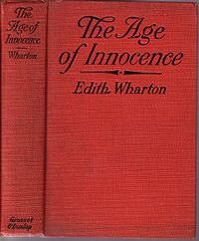


The characters of
The age of Innocence

Slide 3

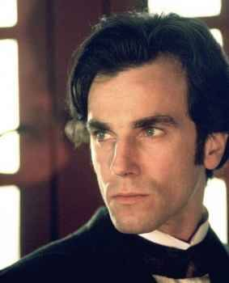
Newland Archer
is the protagonist of the story -- a young, popular, successful lawyer. He lives with his mother and sister in an elegant New York home. Since childhood, his life has been shaped by the customs and expectations of upper class New York society. In the beginning of the novel, he is proud and content to dream about a traditional marriage in which he will be the teacher and his wife, the student. When he meets Ellen Olenska, his life changes. Through his relationship with her -- first friendship, and then love --. He comes to see the inequalities between sexes in New York society and the shallowness of its social customs.
As the novel progresses, Archer is increasingly willing to break the boundaries of acceptable behavior. He follows her first to Skuytercliff, then to Boston, and is finally willing to follow her to Europe. In the end, though, Archer finds that the only place for their love is in his memories.

Slide 4
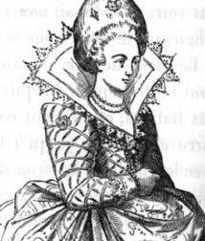
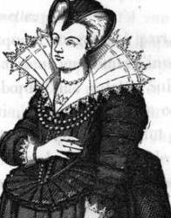
Mrs. Manson Mingott
Grandmother of May and Ellen, Mrs. Mingott is a fat and fiery old aristocratic lady who wields great influence over the New York clan. While her moral standards are irreproachable, she has some unorthodox social views. She insists on family solidarity and remains confident in Ellen, supporting her financially when she leaves
New York to return to Europe

Slide 5
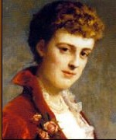
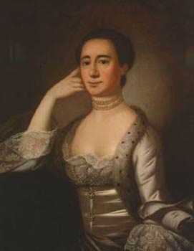
Mrs. Welland
May's mother, has raised her daughter to be a proper society lady. May's lack of imagination and rigid views of appropriate and inappropriate behavior can be largely traced to her mother's influence. Mrs. Welland is a driving force behind May's commitment to a long engagement. Without her mother's influence, May might have agreed early on to Archer's request for an
early wedding. After a couple years of marriage, Archer sees in Mrs. Welland the woman that
May will become - solid, unimaginative, and
dull

Slide 6

Ellen Olenska
is May's cousin and Mrs. Manson Mingott's granddaughter. She became a Countess through her marriage to Count Olenski. At the time the story begins, Ellen has fled her unhappy marriage, lived in Venice with her husband's secretary, and has returned to her family in New York. Ellen is a free spirit who helps Archer to look beyond the narrow scope of New York society. She goes to parties with disreputable people like Julius Beaufort and Mrs. Lemuel Struthers, and she invites Archer, the fiancée of her cousin, to visit her. Ellen suffers just as much as Archer from their impossible love, but she is willing to live in limbo as long as they can love each other from a safe distance. Ellen's love for Archer drives many of her important decisions -- the decision to drop her divorce, to stay in America, and the choice she offers him to sleep with him once and then to disappear from his life forever. When she learns of May's pregnancy, Ellen immediately decides to step out of the picture completely. She refuses Archer's attempts to follow her to Europe, and through this, allows her cousin to start her family with Archer, her husband.

Slide 7
May Welland:
Is Archer's fiancèe and later, his wife. She has been raised to be a perfect wife and mother, and she follows all of society's customs perfectly. Most of the time, she seems to be the type of shallow, uninteresting young woman that New York society adores. When they are in St. Augustine, though, May gives Archer a rare glimpse into maturity and compassion that he had not known was in her. She offers to release him from their engagement so he can marry the woman he truly loves, thinking that he wants to be with Mrs. Rushworth, a married woman with whom he had recently finished an affair. When Archer assures her of his love only for her, May returns to her usual, shallow self. May struggles to reconcile Archer's love of her cousin with the desire to appear happy in front of society, and to give the illusion that she and Archer have the perfect marriage expected of them.

Slide 8
Her unhappiness brings out a manipulative side that Archer doesn't realize until too late
To drive Ellen away from Archer, May tells Ellen of her pregnancy even before she is certain of it. Yet there is still a level of compassion in May, even in the long, boring years of marriage after Ellen leaves. Archer learns after May's death that she had known of his continuing love for Ellen. May, as she lay dying, told Dallas that the children could always trust Archer because he had once given up the thing that meant the most to him to remain loyal to their marriage.

Slide 9
Minor Characters
Christine Nilsson: A famous singer who performs in an opera on the night of Archer and May's engagement
Mrs. Lovell Mingott: May and Ellen's aunt, and the daughter-in-law of Mrs. Manson Mingott.
Lawrence Lefferts: A wealthy young man and a member of Archer's social circle
Sillerton Jackson: The expert on the families that make up New York society.
Julius Beaufort: An arrogant banker who tries to have an affair with Ellen

Slide 10
Regina Beaufort: Julius Beaufort's wife and Mrs. Manson Mingott's niece.
Mrs. Archer: Archer's widowed mother
Mrs. Lemuel Struthers: A woman on the fringes of New York society.
Count Olenski: Ellen's husband. She fled with his secretary to escape the miserable marriage
Duke of Austry: A European Duke
Nastasia: Ellen's Italian maid
Mr. Letterblair: The senior partner of Archer's law firm
Reggie Chivers: An important member of society
And many other character

